Slide 1


Data Analysis Python Project
Blinkit Analysis
Developed by
Tenali Amulya.

Slide 2

Blinkit Analysis
BUSINESS REQUIREMENT
To conduct a comprehensive analysis of Blinkit's sales performance, customer satisfaction, and inventory distribution to identify key insights and opportunities for optimization using various KPIs and visualizations in Python.
KPI’s Requirements
Total Sales: The overall revenue generated from all items sold.
Average Sales: The average revenue per sale.
Number of Items: The total count of different items sold.
Average Rating: The average customer rating for items sold.

Slide 3

blinkit Analysis
BUSINESS REQUIREMENT
Chart’s Requirements
1. Total Sales by Fat Content:
Objective: Analyze the impact of fat content on total sales.
Additional KPI Metrics: Assess how other KPIs (Average Sales, Number of Items, Average Rating) vary with fat content.
Chart Type: Donut Chart.
2. Total Sales by Item Type:
Objective: Identify the performance of different item types in terms of total sales.
Additional KPI Metrics: Assess how other KPIs (Average Sales, Number of Items, Average Rating) vary with fat content.
Chart Type: Bar Chart.
3. Fat Content by Outlet for Total Sales:
Objective: Compare total sales across different outlets segmented by fat content.
Additional KPI Metrics: Assess how other KPIs (Average Sales, Number of Items, Average Rating) vary with fat content.
Chart Type: Stacked Column Chart.

Slide 4
blinkit Analysis
BUSINESS REQUIREMENT
Chart’s Requirements
4. Total Sales by Outlet Establishment:
Objective: Evaluate how the age or type of outlet establishment influences total sales.
Chart Type: Line Chart.
5. Sales by Outlet Size:
Objective: Analyze the correlation between outlet size and total sales.
Chart Type: Donut/ Pie Chart.
6. Sales by Outlet Location:
Objective: Assess the geographic distribution of sales across different locations.
Chart Type: Funnel Map.

Slide 5
Executive summary
1. Product Dominance: Low Fat items are the primary sales engine (64.6% of total sales).
2. Category Leader: Fruits and Vegetables are the top-grossing item type.
3. Location Power: Tier 3 locations and Medium-sized outlets are the highest revenue segments.
4. Key Anomaly: A significant sales dip occurred around 2010, requiring investigation.

Slide 6
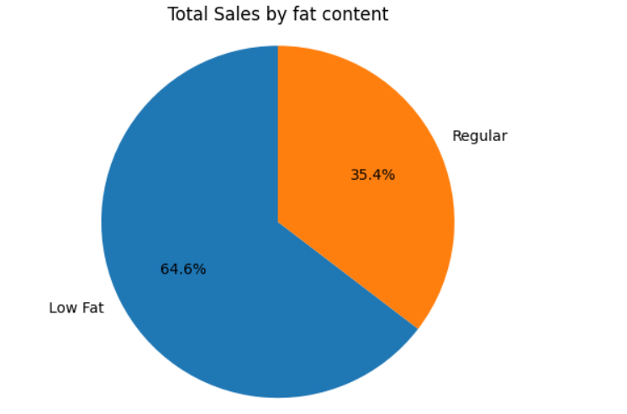
Product Performance: Fat Content and Type
64.6% of total sales come from Low Fat products, indicating a strong customer preference or successful marketing efforts in this area.

Slide 7
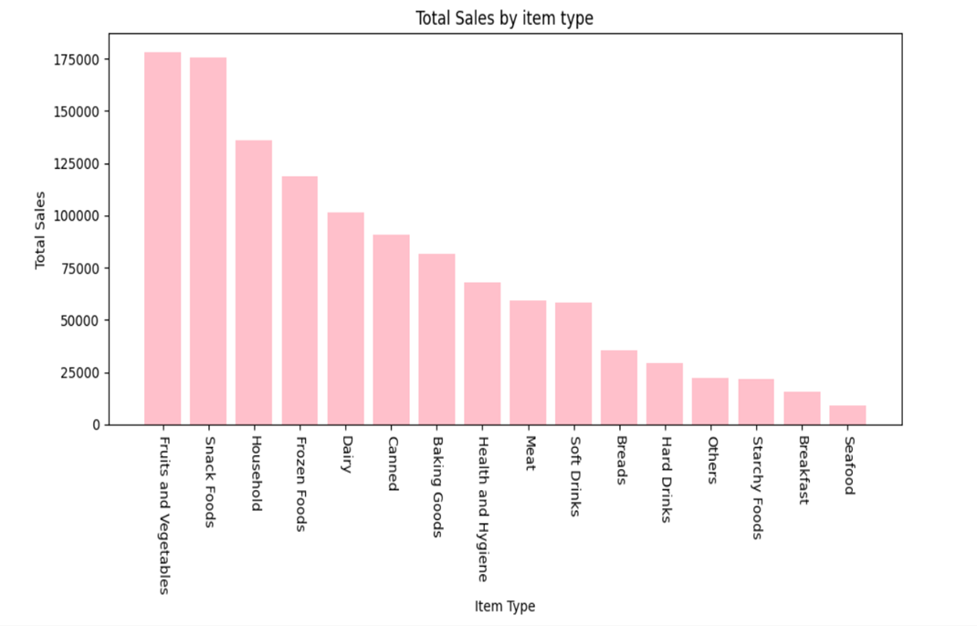
Fruits and Vegetables and Snack Foods are the clear category leaders. Low-performing categories like Seafood and Starchy Foods need targeted intervention.
Recommendation:
Prioritize: Ensure Low Fat products and top categories (F&V, Snacks) receive optimal inventory and shelf space across all stores.

Slide 8
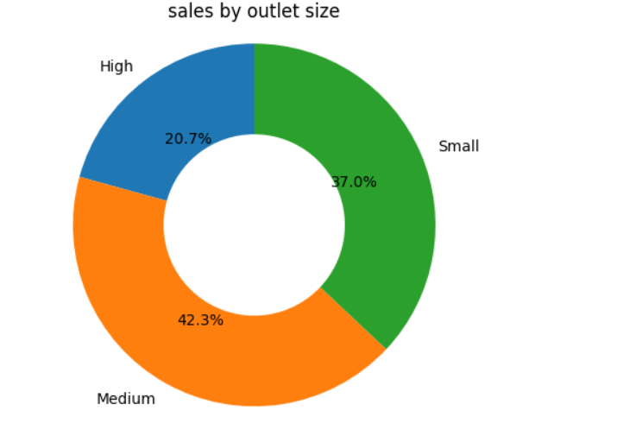
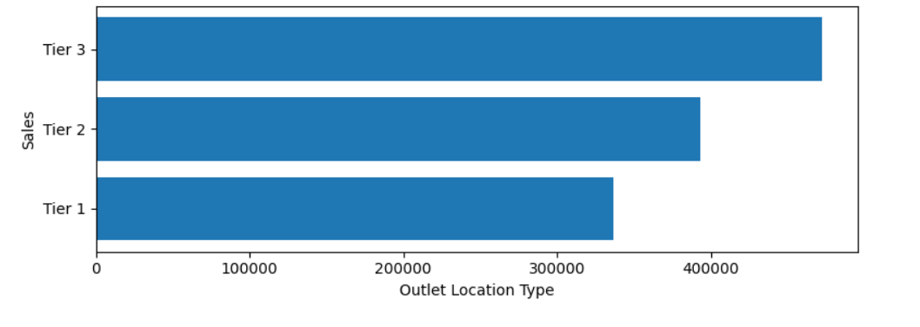
Outlet Location & Size Analysis
Tier 3 outlets generate the highest sales, followed by Tier 2, and then Tier 1. The highest revenue is currently driven by the least urban/dense areas.
Medium-sized outlets are the single largest contributor (42.3%), followed closely by Small (37.0%). Together, they drive nearly 80% of sales.
Recommendation:
Optimize: Analyze the successful operational and merchandising models used in Tier 3 and Medium outlets and replicate those strategies in Tier 1 and High-sized locations.

Slide 9
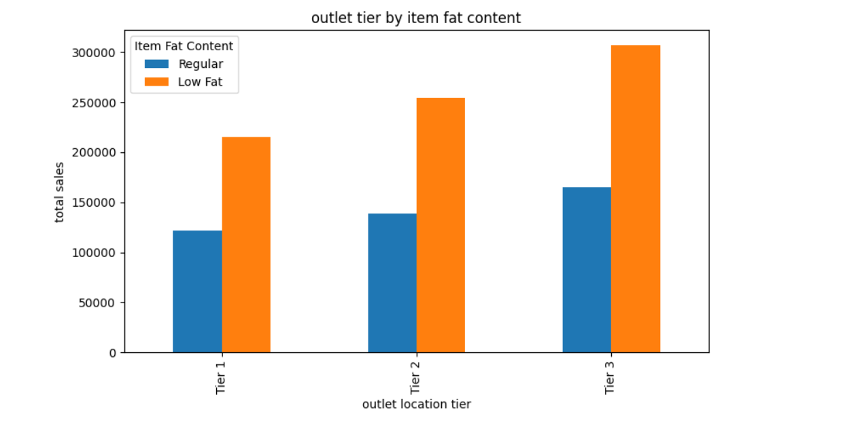
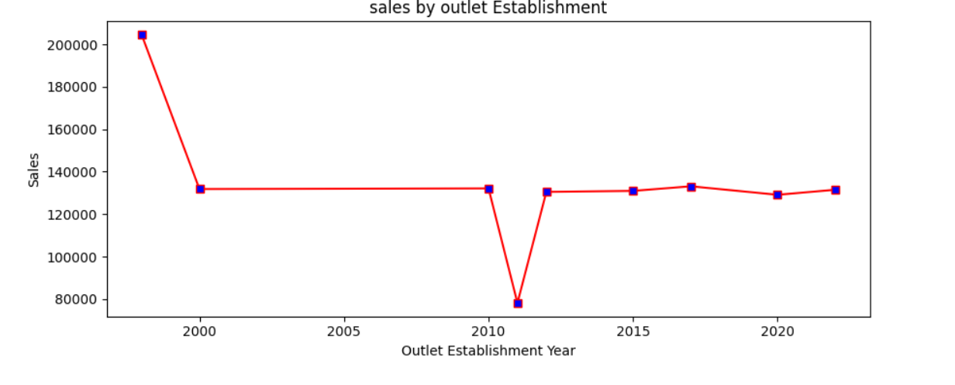
Cross-Analysis & Historical Trend
Sales performance has generally been strong but shows a sharp, noticeable drop around the 2010 establishment year. Sales stabilized significantly in the years following.
The dominance of Low Fat items is universal; it leads sales in Tier 1, Tier 2, AND Tier 3 locations. This is a consistent market trend, not a local anomaly.
Recommendation:
Investigate: Launch a targeted analysis to understand the cause of the 2010 sales dip

Slide 10
Key Recommendations
1. Low-Fat Priority: Confirm marketing and in-store promotions are maximized for Low Fat products.
2. Inventory Review: Reduce stock for consistently low-performing categories (Seafood, Starchy) and increase stock for high-demand items (F&V, Snacks).
3. Tier 3 Replication: Document the best practices from Tier 3 locations (e.g., pricing, assortment) and pilot them in lower-performing Tier 1 stores.
4. High-Size Strategy: Develop a specialized strategy for High-sized outlets to increase their sales share, potentially by introducing new services or a wider premium product assortment.

